Slide 1


Hospital Management
Yash Gaude (2316)
Samuel Lucas (2324)
Brian lobo (2347)
Github Link - https://github.com/yash2316/Hospital-Management-System

Slide 2


Contents
Introduction
Project Scope
Database Schemas
Technologies Used

Slide 3
Introduction
Hospital management plays a crucial role in ensuring the smooth functioning of healthcare facilities, optimizing patient care, and improving overall operational efficiency.
This not only improves the overall efficiency but also enhances the patient experience by ensuring accurate and proper treatment.

Slide 4
Project Scope
Our hospital management web application efficiently handles patient interactions, including registration, appointment scheduling. It provides robust reporting and analytics for insights into patient demographics and financial performance, all while ensuring data security. If the doctor agrees with the appointment the doctor can prescribe medicines if not then he/she can also cancel the appointment.

Slide 5
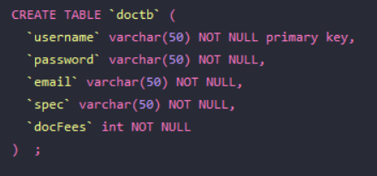
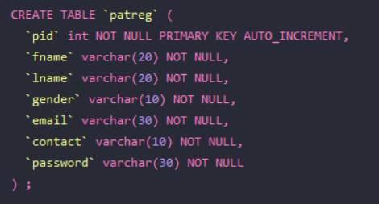
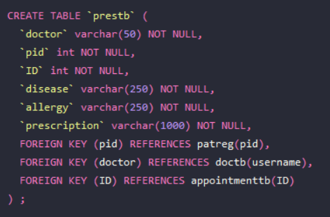
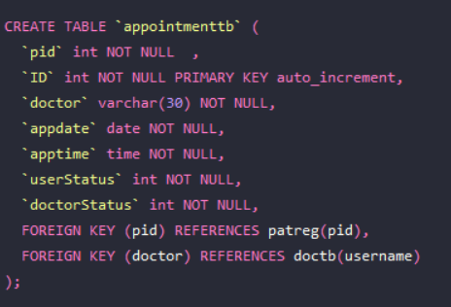
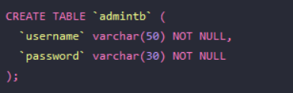
Database Schemas

Slide 6



Technologies Used

